Slide 1
L-3, Shedding Mechanism of Loom
Loom Drive
Loom is driven by motor
Motor pulley is engaged with crank shaft pulley with belt
Crank shaft gear engaged with bottom shaft gear
Crank gear teeth: bottom shaft gear teeth is 1:2
Crank shaft rpm : bottom shaft rpm is 2:1
Note: for drive , go through the fig in study material

Slide 2
Crank shaft rpm = picks per minute =speed is the loom
Crank rpm =motor rpm X (motor pulley dia / Loom pulley dia)
Bottom shaft rpm = crank shaft rpm X (Crank gear teeth / bottom shaft gear teeth)
Loom Timings:
Rotation of crank is divided in four angular groups
0º→ Top, 90º→ Front, 180º→ Bottom, 270º→ Back

Slide 3
Shedding
Object: division of single layer of warp sheet in to two layer is known as shedding
Sheds are formed with the help of heald shafts
There are three shedding mechanisms-
Tappet
Dobby
Jacquard

Slide 4
Type of sheds
Open sheds:
In fully opened shed, the shed is always in open position
Two stationary lines are formed (one at top & other on bottom)
after insertion of pick, threads from top position comes lower at a centre position and threads of bottom position raised to that centre position

Slide 5
In semi open shed, a stationary bottom line is retained.
The top line is movable one.
After insertion of pick, the top line moves towards the bottom line.
Closed Sheds:
Shed closes after insertion of pick
In centre close shed, warp threads move in upward & downward direction from a centre line.
Both the lines meet at the centre line after insertion of pick

Slide 6
Bottom closed shed:
This is formed by giving motion to only those threads that form the top line
After insertion of pick, all warp threads come to the bottom line

Slide 7
These are two types:
Positive: in this tappets control upward & downward movements of heald
(Ref: see the tappet in study material)
Negative: If tappet controls only one way movement of healds either in upward or downward movement of healds.
Heald shafts are returnrd by the external devices like dead weight, roller, springs etc.

Slide 8
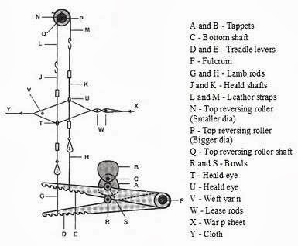
Negative Tappet Shedding Mechanism Construction

Slide 9
Timings and Setting:
Turn the crank to the top centre position.
Fix the anti-friction bowls to the treadle levers; they should move freely in the slots.
Fix the treadle levers with a bracket to the back rail of the loom.
Set the grid and grid bracket to the front rail of the loom in the slots of the grid.
Make sure that the tappet with the lower throw is fixed to the bottom shaft at the starting handle side.

Slide 10
Fix the top reversing rollers to the top reversing roller shaft to be equidistant from the ends and at the same time ensure that the connecting screws of the rollers are symmetrical about the central axis of the shaft when the heald shafts are at the same level. The roller of smaller diameter is always connected to front heald shaft.
The heald shafts are connected to the top reversing rollers by means of cords and leather straps. The leather straps are connected to the rollers, such that when one of them winds on its roller the other strap unwinds from its roller and vice versa.
Lamb rods are connected to the heald shafts by cords.
Adjust the tappets on the bottom shaft and make sure of the following points:

Slide 11
Advantages and Disadvantages of Tappet Shedding:
Advantages:
It is robust, simple and cheap
It is capable of lifting a heavy weight with less wear and tear than other shedding mechanisms.
It can move heald shafts at great speeds.
It puts less strain upon the warp.
It consumes less power and gives greater output.
It requires less maintenance

Slide 12
Disadvantages:
If the weave is changed, it will be necessary to change the tappet and the change gear wheel in the counter shaft arrangement.
So work involved in changing the weave is more.
The capacity of a tappet to produce a pattern / weave is very much limited. A maximum of 8 or 10 tappets only can be used.

Slide 13
Dobby Shedding
This is a compact, electronically guided shedding motion and capable of having up to 28 shafts. More complex and versatile shedding motion. A dobby loom, therefore, can have up to 28 shafts, and much greater weave repeat is possible. Design may be woven with two or more basic weaves and their variation. Such fabrics may be referred as dobby cloths or dobby weave, towels usually show geometric designs when pattern is provided by dobby.

Slide 14
Principle of Negative Dobby Shedding:
In this type of shed, lowering of the heald frame occurred mechanically.
Construction:
In the negative shedding the heald frames are operated by the jack & lever.
The levers are connected with the knife and the knifes are attached with the driving rod by means of connecting needle.
A pattern is used here according to the weave plan. When the teeth of chain is come to the contact of chain drum then whole the arrangement moves together and lowering of the heald frame is occurred by the spring.

Slide 15
Working Principle:
The lowering of the heald frame is happens here by spring or jack lever.
When the pattern cylinder doesn’t find peg on the pattern drum then bauck lever and jack lever bring the heald frame in downward direction,
therefore the the lowering of the heald frame is occurred by means of spring tension.

Slide 16
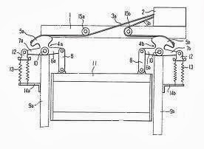

Slide 17
Advantages of Negative Dobby:
Highly complex and critical fabrics can be weaved.
At a time it can control many heald frame
Faste than the positive dobby as well as over conventional loom
Can produce close bottom shed

Slide 18
Disadvantages of Negative Dobby:
In this shed only lowering of the shed is possible Due to more stress, yarn breakages more
It is not good for heavier fabric
It does not provide more high speed to the loom

Slide 19
Positive Dobby Shedding
Principles of positive dobby
In this type of shed lifting & lowering of the heald frame both is possible.
Lifting is occurred by means of jack & lever
lowering is occurred by means of spring under tension.

Slide 20
Construction and Working Principle:
Positive dobby shedding is the combination of three Cylinders, jack lever, spring and a shaft
Between the three cylinders a shaft is fulcrum in one side the upper cylinder moves as the anti clockwise and lower cylinder moves as the clock wise direction
The main cylinder when get motion from the shaft when it found peg or pattern plan then the cylinder attached with the upper half toothed disc

Slide 21
So that the heald frame is up & when the pattern cylinder doesn’t found peg then the main cylinder attached with the lower half toothed disc
and the spring retains the heald frame to the downward direction

Slide 22
Jacquard Shedding:
To provide with unlimited design width, jacquard shedding is needed
This shedding motion has no shafts, instead, a hardness consisting of as many cords as there are ends in the warp sheet connects each end individually to the jacquard machine
Each warp could weave independently of all others. Complex and most versatile shedding motion
Biggest weave is possible with jacquard shedding as each warp yarn may be individually controlled.

Slide 23
A Jacquard attachment has blades, hooks, needles, a griffe, griffe hooks, and a perforated cylinder
The warp strands, drawn through the heddle eyes, are tied to the loom by harness cords, which are threaded through a comber board for even distribution over the width of the loom
The blades set in a blade frame, move up and down. The hooks that are near the blades are engaged by them and lifted up, and the warp strands are also lifted by the griffe hooks and harness cords to form the upper part of the shed (the warp yarn in the fabric)
Hooks that are out of reach of the blades drop, together with the griffe. The hooks and the warp strands drop because they are attached to weights
The lowered strands of the warp yarn form the lower part of the shed (the woof yarn in the fabric)

Slide 24
The hooks coming from the area of the blades’ action are drawn out by needles activated by the cylinder, which in turn has a rocking and rotating motion
A piece of cardboard consisting of individual paper cards is placed on the cylinder
These cards have perforations, and when a needle comes to a perforation it enters the cylinder and the hook stays near the blade, but when a needle does not meet a perforation it is pushed back and the hook is kept away from the knife
By combining perforated and un perforated places on the cards it is possible to exercise complete control over the raising and lowering of warp strands and to form a design on the fabric.

Slide 25
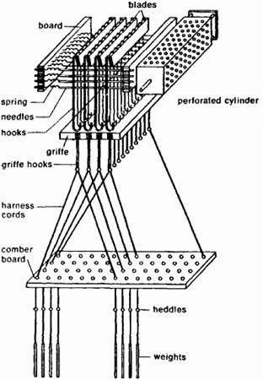

Slide 26
Advantages of Jacquard Shedding
Jacquard shedding mechanisms are capable of producing large and intricate weave designs that are beyond the scope of dobby shedding mechanisms
In jacquard weaving, it is possible to control every warp yarn individually
Many specialized types of jacquard machine have been developed for weaving particular kinds of fabric, such as terry towels, damasks, and carpets
Most of the rest are general purpose types that are comparatively easy to classify

Slide 27
For details, students may go through study material which is uploaded online
In case of any query, students may ask on my contact no between 8.00-9.00 pm on my contact no: 8953911070/9415737371
“This is end of lecture-1 &2”

